Slide 1
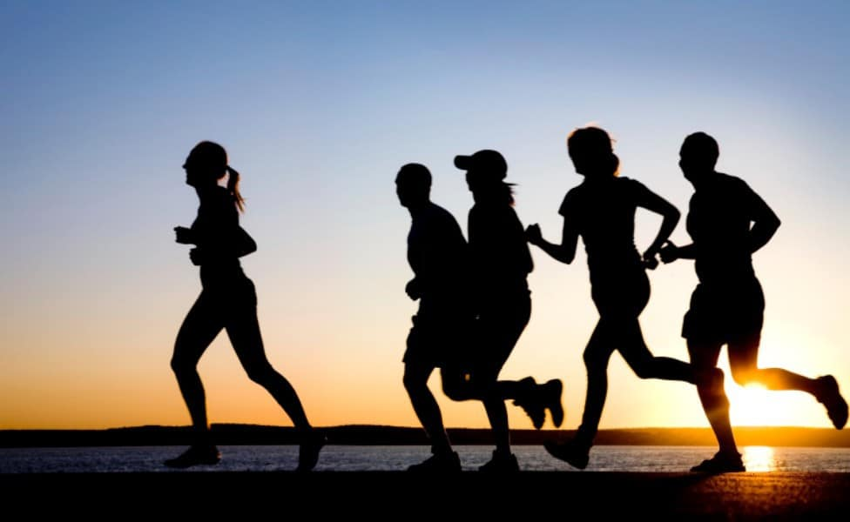

Slide 2

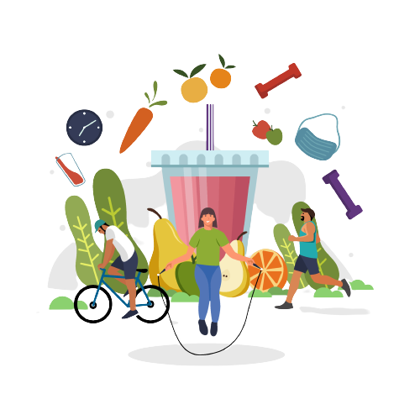
Healthy lifestyle
GROUP 6
Chanthou Voeun
Layhor Met
Lieb Toeu

Slide 3
CONTENTS
01
Be more active
Do exercise
02
Nutrition
Food, vegetable, drink
03
Stress management
Listen to music, sleep, communication with other
04
Self-care
Lower risk of illness, increase inergy

Slide 4
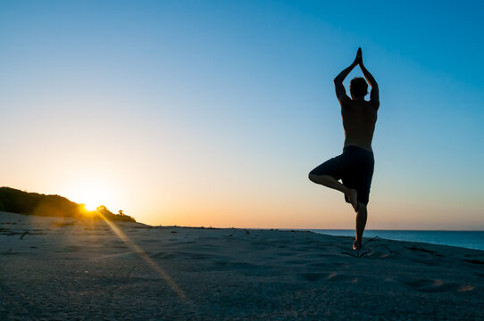
What is healthy lifestyle?

Slide 5
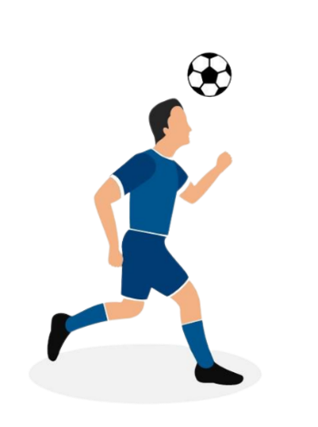
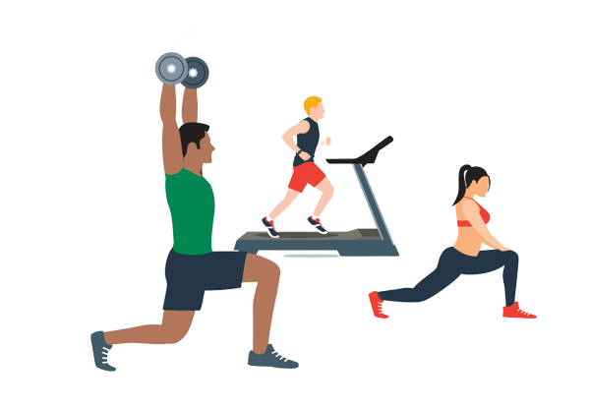
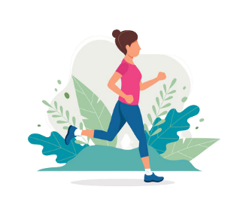

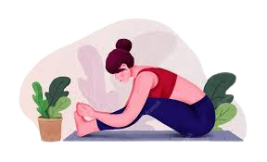
Be more active...
Play sports...
Gymg
Runnig every day
Yoga
Dancing

Slide 6
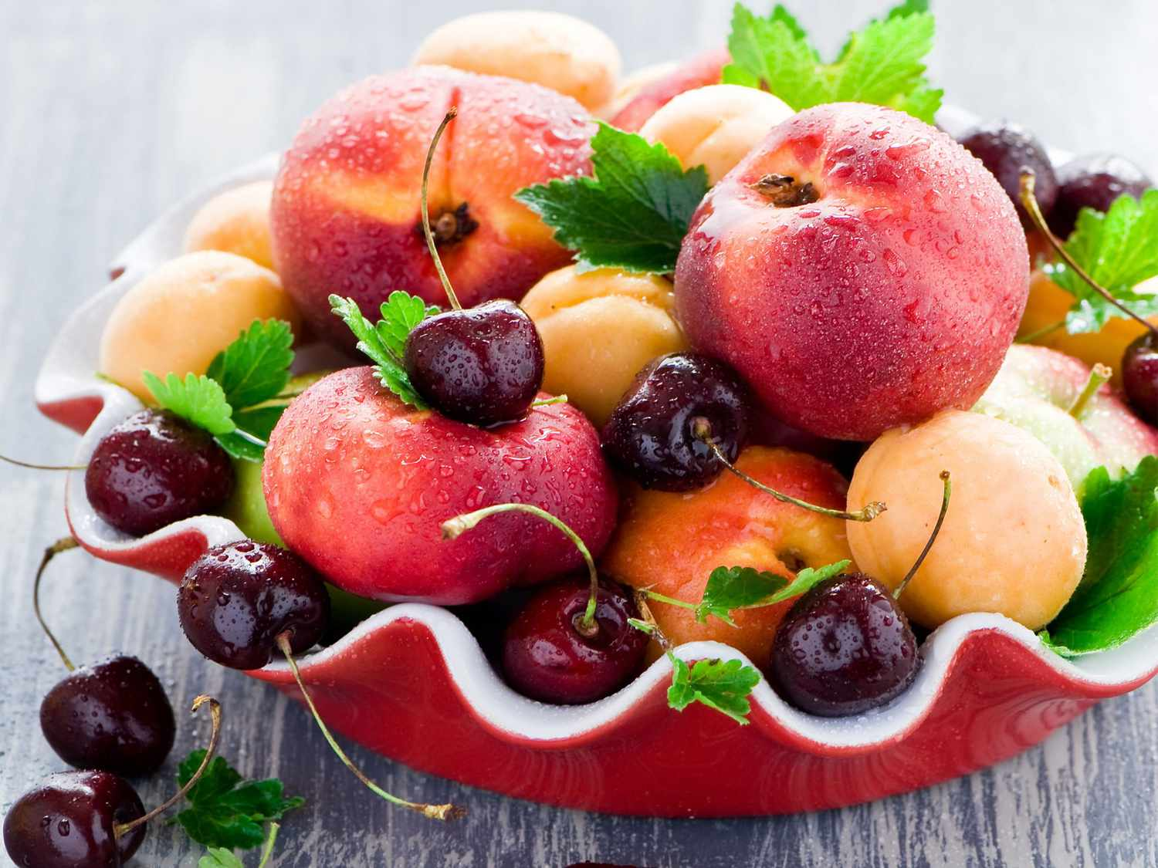
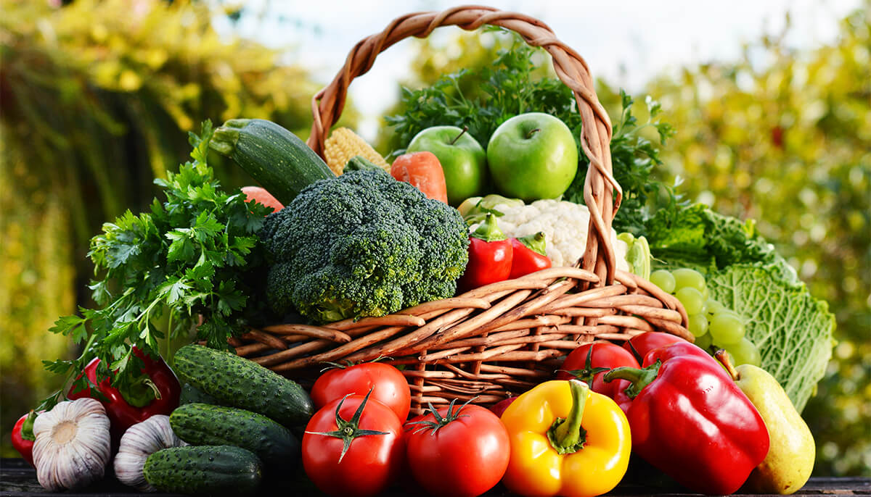
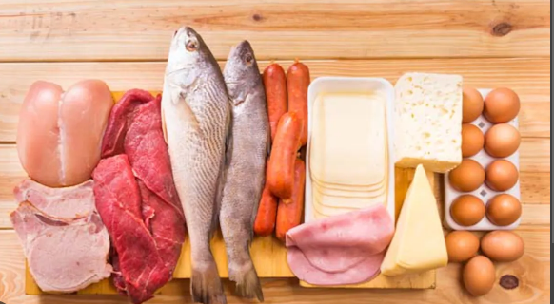
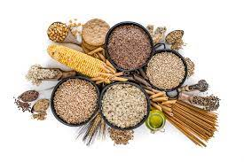
Nutrition
Eat a well-balanced, low-fat diet...
Eat pleny of fruits of all colors
Eat more vegetables
Choose fish, poultry, beans, and nuts, limit red meat and cheese.
Eat a variety of whole grains(such as whole-wheat bread, pasta and brown rice).

Slide 7

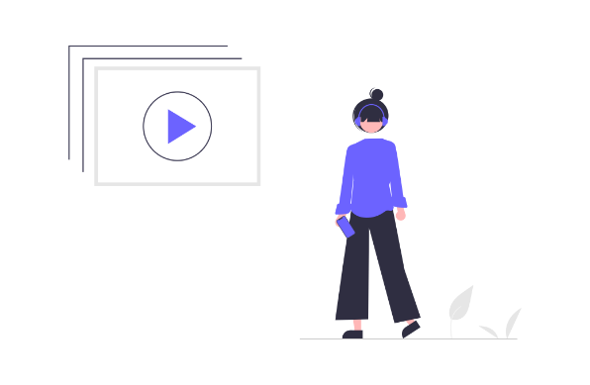
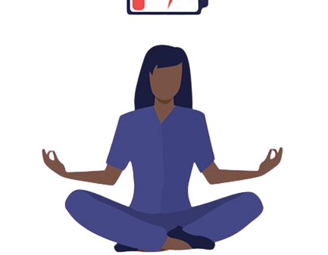
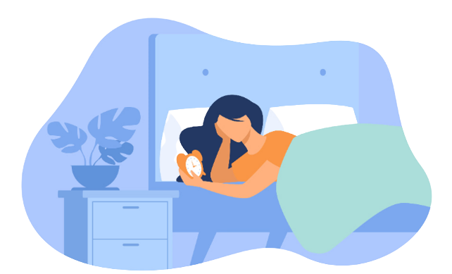
Stress management
Communication with other
Listen to music
Control stress
Meditate
Sleeping

Slide 8
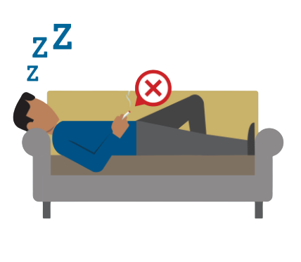
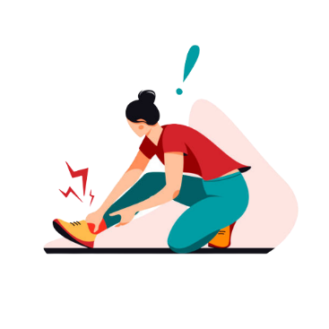
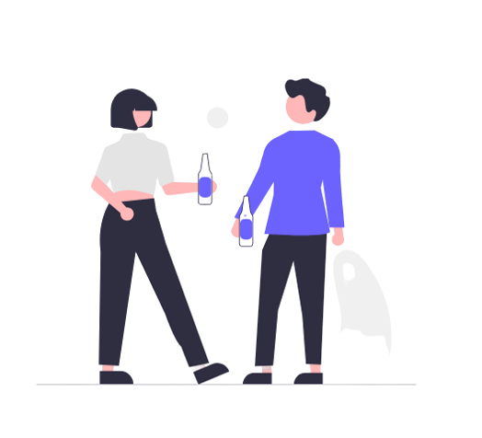
Self-care
Don’t smoke
Avoid injury
Don’t drink beer

Slide 9
In conclusion
healthy lifestyle not only makes a person confident and productive but also make all of yuo to success and got a good healthy in your life.

Slide 10

THANK YOU
For your attention

